Slide 1
Honors Program Thesis Formatting Workshop March 14, 2024
If you are defending this spring:
The full, formatted draft of your thesis is due to thesis@baylor.edu for our formatting review by
Thursday, April 18th (during Honors Week).
*UNSC majors should also submit to University_Scholars@baylor.edu.

Slide 2
HP Thesis Formatting Guidelines:
Honors Program Website, under Current Students: Thesis: Thesis Format
https://program.honors.baylor.edu/current-students/thesis/thesis-format
Why does formatting matter?
“The Honors Program requires each of its students to conduct, under the supervision of a Baylor faculty member, a project that represents independent research or some other form of advanced scholarship. The product of such scholarship is an Honors thesis. Copies of each such thesis are bound and archived in the office of the Honors Program. The quality of these works reflects the standards of Baylor University, the Honors College, the Honors Program, your department or institute, and the professors who work with you on this project. Most importantly, the quality of your Honors thesis reflects upon your professionalism” (Guidelines 12).

Slide 3
What style guidelines do I follow for my thesis?
See pages 12-13 of the Guide
Part A: content, writing style, and format (incl. citations): you + mentor
Often, the standard style guide followed for a graduate-level dissertation or thesis in the given discipline; however, the final decision on style manual should be made by your thesis mentor.
Part B: uniform elements across all theses
“The Honors Program defines in this document the standard style and format that should apply to all theses completed as part of the program’s curriculum.”
For any style guide, follow this rule:
“If a conflict occurs between these Honors Program guidelines and the discipline-specific style guide, then the Honors Program guidelines should take precedence. Where neither departmental nor Honors Program specifications resolve a question, you should refer to Turabian’s Manual for Writers of Term Papers, Theses, and Dissertations. In the end, you must be consistent in using the adopted style throughout the document” (13).

Slide 4
Formatting Basics (p. 14-31 of the Guide)
Typeface and size (14)
Margins (15)
Spacing (15)
Page Numbers (15; some links to guides, 23)
Justification and hyphenation (16)
Footnotes or endnotes (16-17)
Headings (17-19)
Order of thesis components (20)
Your new best friend: THE APPENDIX (35-42)

Slide 5
Exercises: Set Up of Preliminary Pages
Note: The following instructions and examples are particular to MS Word for Microsoft 365. Apple products and other versions of Word may have slight differences, especially in terms of things like icons and where various features are found on the screen. Most users are able to use these instructions as a starting point and fairly easily find the adjustments they need to make for their program/computer. If you are getting stuck, Googling “how to ____ in Word” usually works.
Workshop instructions: Open (or create) a “formatting draft” of your thesis document to play around with. If you don’t have these pages yet, for the purposes of the next few minutes create at least 3 pages (TITLE PAGE, TABLE OF CONTENTS, CHAPTER ONE—centered and in all caps).

Slide 6
Page Numbers (see p. 20, 23, and the Appendix of the Guide)
There are three types of page numbers in your thesis:
Section 1: unpaginated = abstract, signature page, title page
Section 2: Roman numerals = Table of Contents and any other optional ‘front matter’ (List of Figures, Acknowledgments, Epigraph, etc.)
Note: the first paginated page will actually be page “ii,” not page “i.”
Section 3: Arabic numerals = first page of the first chapter through the end of the thesis (including any appendices and the bibliography).
Page numbers in this section start with “1” and number continuously from there.
All page numbers should be centered at the bottom of the page (with the bottom margin set to 1 inch).
Make sure that the font and size of the page numbers match that of the body text!

Slide 7
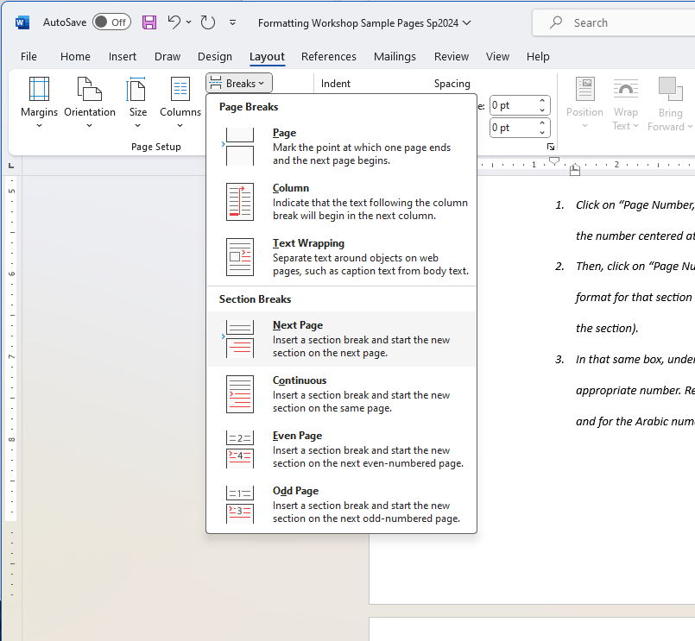
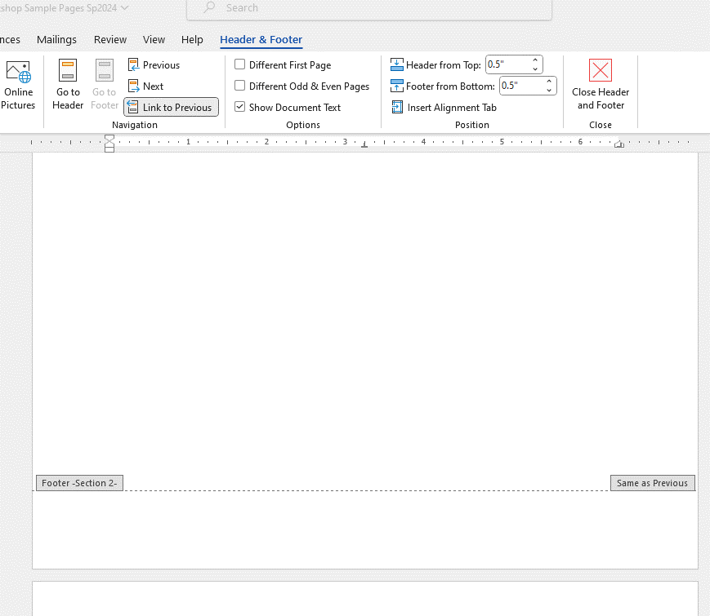
Formatting Page Numbers Using Section Divisions in MS Word
To format your page numbers in Word, use section breaks between the three types of page numbers (unpaginated, roman numeral, and Arabic numeral), and be sure to “unlink to previous” for each section break.
Put your cursor at the end of the text on the last page of a section. Click on “Layout,” then “Breaks.” Under “Section Breaks,” click on “Next Page.”
On the first page of the next section, double click at the bottom of the page to open the footer for that page. Then, under “Header and Footer,” make sure to deselect the “Link to Previous” button. (Word defaults to linking the headers and footers of sections together, and that is NOT what we want here.)
Repeat steps 1 and 2 to create all three sections and unlink them from each other.
DESELECT this option
Click here to open the footer

Slide 8
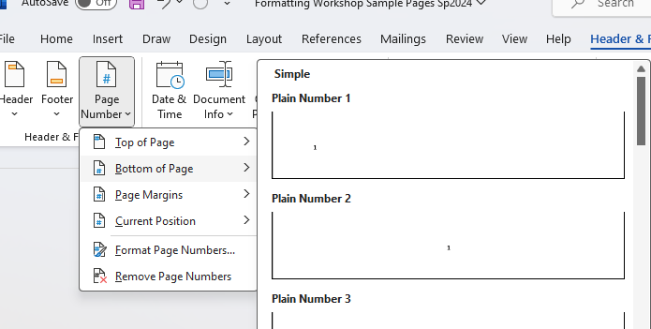
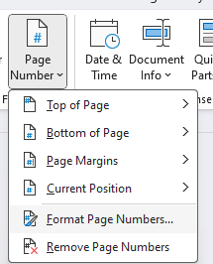
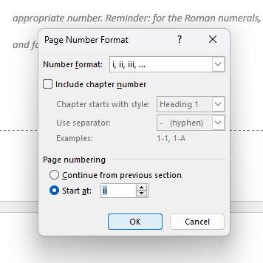
Formatting Page Numbers Using Section Divisions in MS Word
4. While you’re still in the Headers/Footers page on the first page of a new section, format the page numbers for both sections 2 (Roman numerals) and 3 (Arabic numerals). Remember, section 1 is unpaginated!
Click on “Page Number,” “Bottom of Page,” and select “Plain Number 2” (with the number centered at the bottom of the page).
Then, click on “Page Number,” “Page Number Format,” and select the number format for that section (lowercase Roman numerals or Arabic numerals, dep. on the section).
In that same box, under “Page numbering,” select “Start at:” and choose the appropriate number. Reminder: for the Roman numerals, you will start at “ii,” and for the Arabic numerals, “1.”
If need be, go back to section 1 (the unpaginated pages, and remove the page number there IF one showed up (if so, double-check that the sections are unlinked!). As long as the sections are UNLINKED from each other, this should not cause changes to the other sections’ page numbers.

Slide 9
Headings (for sections, subsections, etc.) (see p. 17-19 and 40 of the Guide)
Spacing: you will use single-, double-, and triple-spaced text in your thesis. See examples in red on the following slides.
Single = no blank space between lines.
Double = one full blank line between lines of text.
Triple = two (and only two!) blank lines between lines of text.

Slide 10
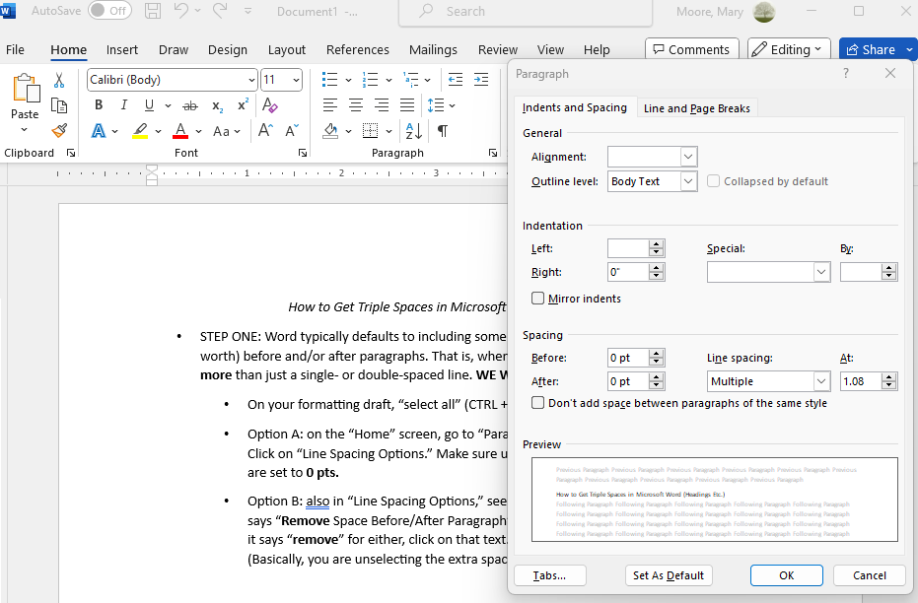
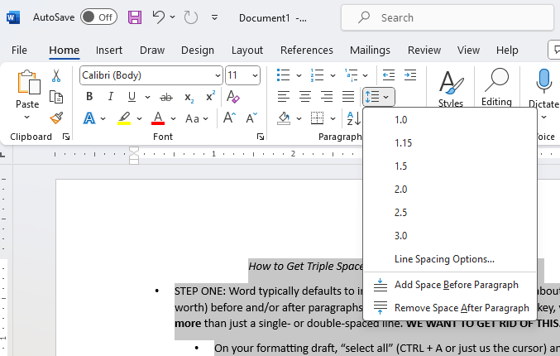
Getting Triple Spaces in Word (headings etc.):
STEP ONE: Word typically defaults to including some extra space (usually about half a line’s worth) before and/or after paragraphs. That is, when you hit the “return” key, you end up with more than just a single- or double-spaced line. WE WANT TO GET RID OF THIS.
On your formatting draft, “select all” (CTRL + A or just using the cursor) and then:
Option A: on the “Home” screen, go to “Paragraph,” then “Line and Paragraph Spacing.” Click on “Line Spacing Options,” then “Indents and Spacing.” Make sure under “Spacing,” both “Before” and “After” are set to 0 pts.
Option B: also in “Line Spacing Options,” see whether the text at the bottom of the box says “Remove Space Before/After Paragraph” or “Add Space Before/After Paragraph.” If it says “remove” for either, click on that text. You want both of those lines to say “add.” (Basically, you are unselecting the extra space.)

Slide 11
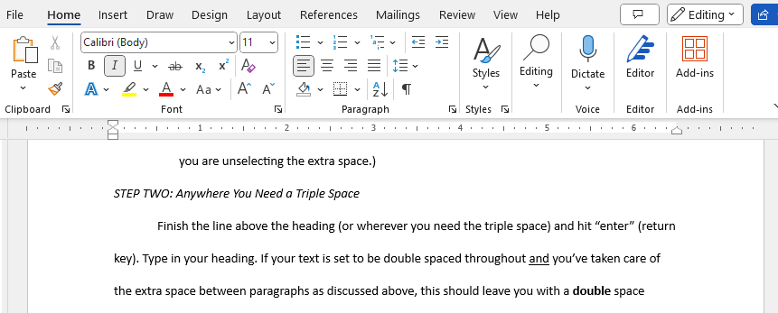
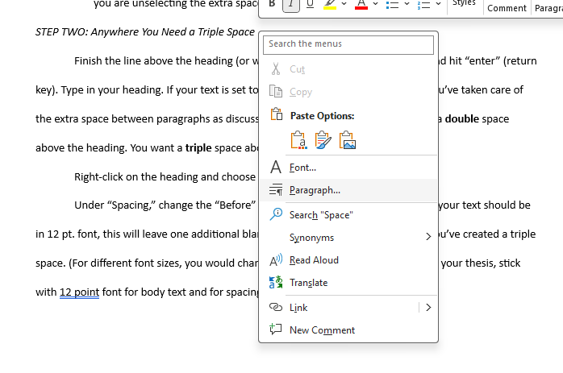
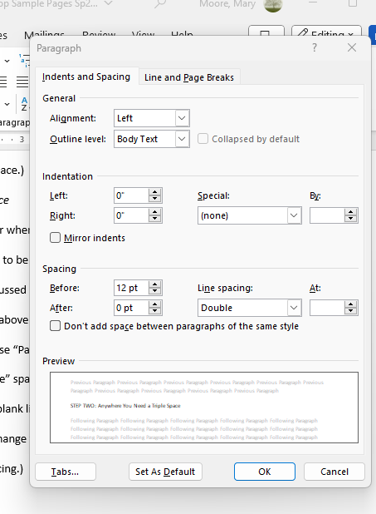
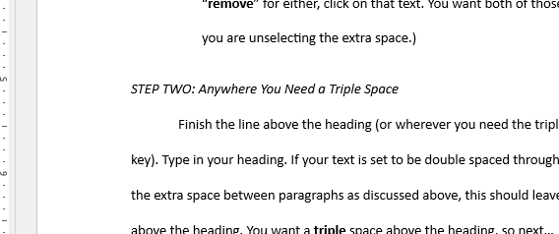
Getting Triple Spaces in Word (headings etc.):
STEP TWO: anywhere you need a triple space
Finish the line above the heading (or wherever you need the triple space), and hit “enter” (return key). Type in your heading.
If your text is set to be double spaced throughout and you’ve taken care of the extra space between paragraphs as discussed above, this should leave you with a double space above the heading. You want a triple space above the heading, so next….
Right-click on the heading and choose “Paragraph.”
Under “Spacing,” change the “Before” spacing from “0 pt.” to “12 pt.” Since your text should be in 12 pt. font, this will leave one additional blank line above that paragraph. Tada! You’ve created a triple space. (For different font sizes, you would change what you enter in this box. But for your thesis, stick with 12 point font for body text and for spacing.)
Repeat each time you need a triple space in your text (headings, before/after charts and figures, etc.).
Heading (double spaced above and below)
Result
Heading (triple spaced above, double spaced below)

Slide 12
Other Questions?
A very handy tip:
When in doubt, forget the bells and whistles.
That is, sometimes it is easier/faster/more accurate to do something ‘manually’ rather than to try to adjust the settings in your program.
For example: for the first page of a new chapter, simply use the “return” key and the side ruler to get the top margin to 1.5 inches, rather than trying to adjust the top margin settings for just that page.
Ultimately, the measure of success is how things look on the printed page, not how “tidy” the behind-the-scenes work is.
Today: continue working on individual formatting issues with Ms. Moore, Dr. Beck, and your peers.
Outside this workshop: if you can’t figure it out in the style guide or our Formatting Guidelines document, try Googling the problem. Then, email Dr. Beck or Ms. Moore if you are stuck!

